Slide 1





CloudCompare
Tutorial
Daniel Girardeau-Montaut
www.cloudcompare.org
@CloudCompareGPL
daniel.girardeau@gmail.com

Slide 2
Preparation
Interactive tutorial!
Get the presentations and data samples
(from the USB thumb drives)
Install CloudCompare 2.7 or 2.8.beta:
www.cloudcompare.org/release

Slide 3
Plan
Presentation of the CloudCompare project
Generalities
  Level 1: graphical interface, display, manipulations, etc.
  Level 1.5 : scalar fields
Advanced pocessings
  Level 2: registration, distances computation, etc.
Quick overview of the other features
Questions / improvisation

Slide 4
Presentation
CloudCompare

Slide 5
Generalities

Slide 6
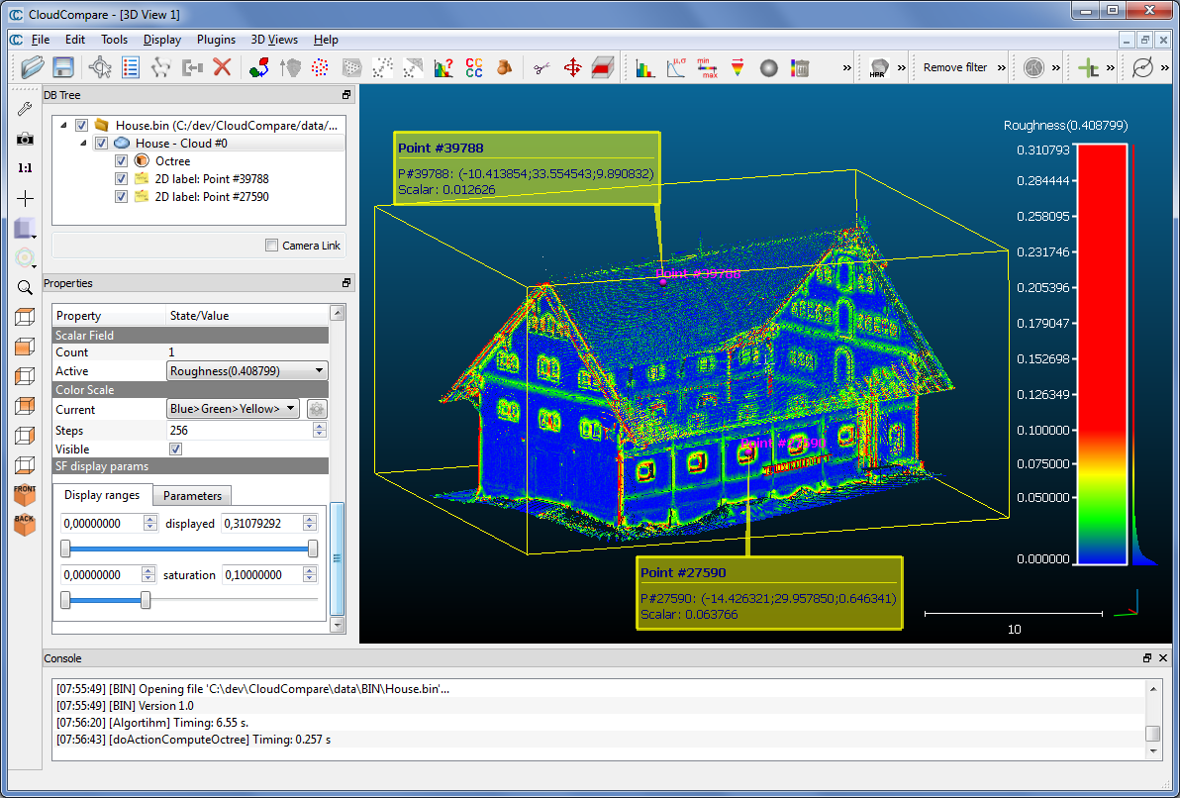
Graphical user interface
menus + toolbars
database
3D view(s)
“3D view” tools
highlighted entity properties
Console

Slide 7
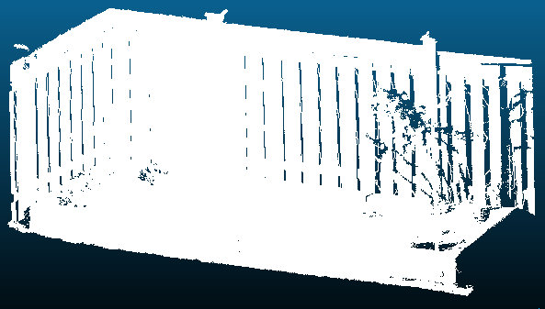
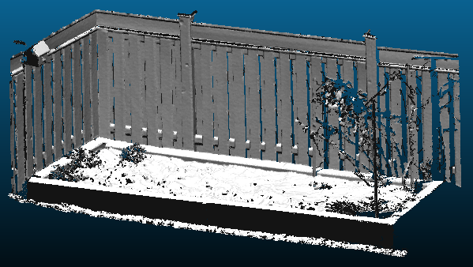
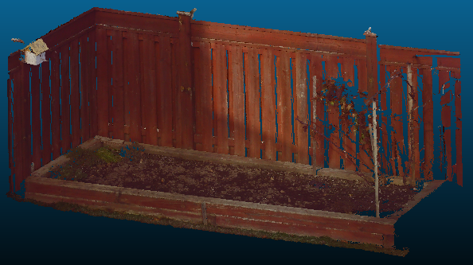
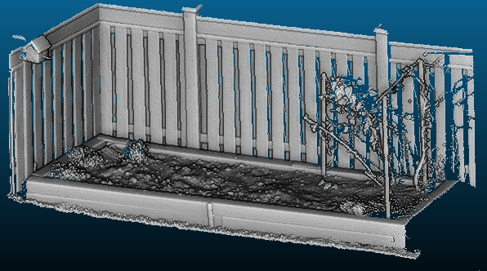
Point cloud display
Raw cloud
Normals (slow ☹)
RGB
EDL (fast ☺)

Slide 8


File formats
Mainly point clouds…
(ASC/PTS, LAS/LAZ, E57, PTX, PCD, Faro, DP, Riegl, etc.)
… and triangular meshes
(PLY, OBJ, STL, OFF, FBX)
A dedicated format: BIN (to save « projects »)
  Other formats:
    SfM (Bundler .OUT)
    Photoscan (work in progress)
    CAO (Autocad DXF, Aveva PDMS)
    SIG (shapefile SHP)
    Polylines (SALOME hydro, SinusX, etc.)
1 - load file

Slide 9
Level 1
Basic manipulations
Interactive transformation
Interactive segmentation
Sub-sampling
Other standards tools:
  colors and normals edition
  scaling, cloning and merging
  cross section
2 – L1 manipulations

Slide 10
Level 1.5
Scalar fields
Operations on scalar fields
Color scales
3 – scalar fields

Slide 11
Level 2
Registration
Distances computation
Other tools
4 – registration
5 – distances
6 – other tools

Slide 12
Present and share your results

Slide 13
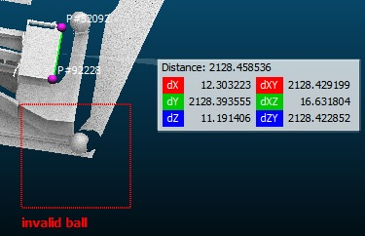
Present and Share
Display
  labels
  Multi 3D views support, full-screen mode, etc.
  Viewports can be saved (Display > Save viewport)
Export 3D views to image with optional super resolution
(X2, X3, X4, etc. – Display > Render to file)
Save ‘projects’ in BIN format (can contain several entities, of all types)

Slide 14
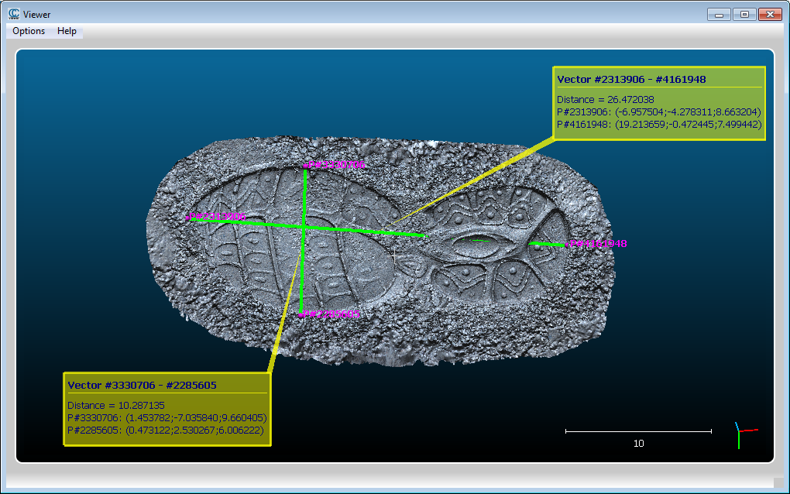
ccViewer
Light client, to load and visualize various file types

Slide 15
Other

Slide 16
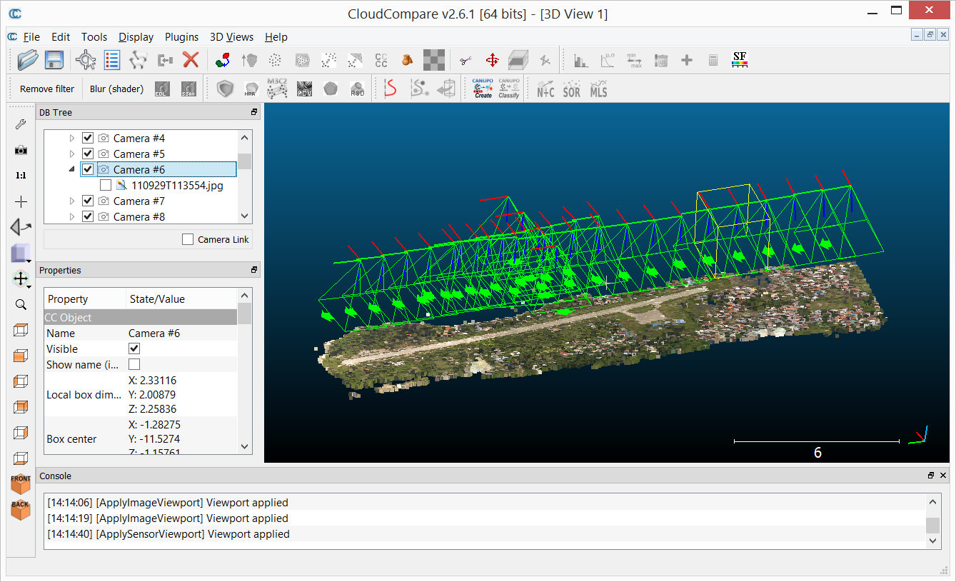
SfM data
Bundler (.OUT) file loading support
  import keypoints
  import calibrated pictures (+ sensor)
  ortho-rectification
+ Photoscan project files (PSX, etc.) loading support under development

Slide 17
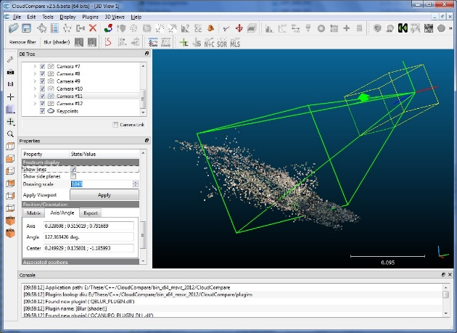
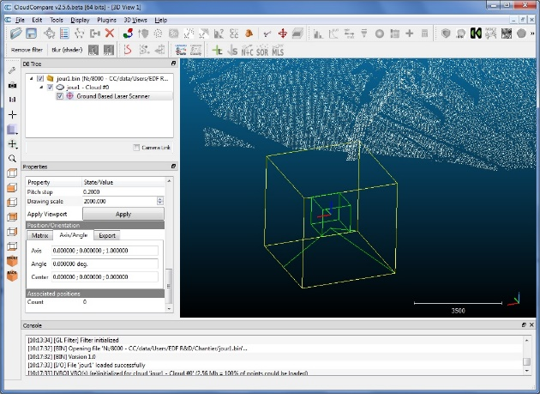
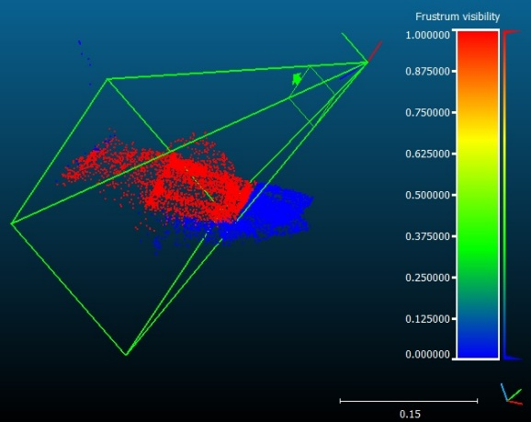
Sensors
‘Sensor’ entities
  TLS (Terrestrial Laser Sensor) = GBL (Ground Based Lidar)
  Projective cameras
Operations:
  Set the virtual (OpenGL) camera to match the sensor point of view
  Filter points based on their visibility
  Compute distance to sensor, scattering angle, etc.

Slide 18
Misc
  Compute distances or angles between particular points
  Fit planes or spheres on point clouds
  Meshing (Delaunay 2.5D or Poisson)
  Command line
  Plugins
  etc.
  Wiki: http://www.cloudcompare.org/doc/wiki
7 – plugins

Slide 19
Next

Slide 20
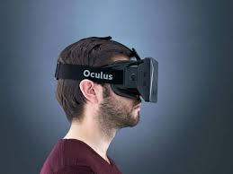
In preparation
Near future:
  version 2.8
  Oculus Rift support
  « full wave form » (FWF)
  LIDAR data support
  New plugins (qHoughNormals, qBroom)
A little bit later:
  "out of core" clouds support
TODO list:
  https://github.com/cloudcompare/trunk/blob/master/qCC/TODO.txt

Slide 21
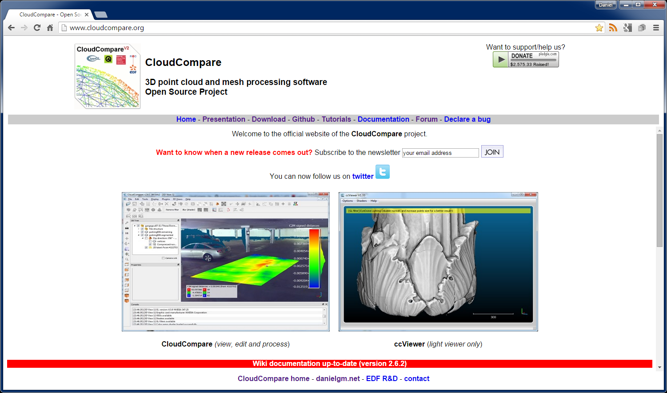
Thanks for attending this tutorial!
www.cloudcompare.org

